Slide 1
Presentation Slide ON K-Nearest Neighbor Algorithm

Slide 2
What is K-NN?
K-Nearest neighbors is a simple algorithm that stores all available cases.
Classifies new cases based on a similarity measure(distance functions).
The kNN classifier
with an edited training set in order to improve the performance of the classifier in terms of error rate.

Slide 3
Why kNN is stored available cases??
K-NN is stored the all available cases because of comparing the unclassified record with the stored record :
i) Based on the most similar training set.
ii) To find the unknown record or set.

Slide 4
Which is the key word of K-NN?
The word ‘distance ’ is the main key word in K-NN.
Another one is the value of the parameters ‘K’ which focus the number of nearest neighbors.
Here a case is classified by the majority vote of its neighbors.Like as, if K=3 and the classes are a &c then we see it in below figure:

Slide 5
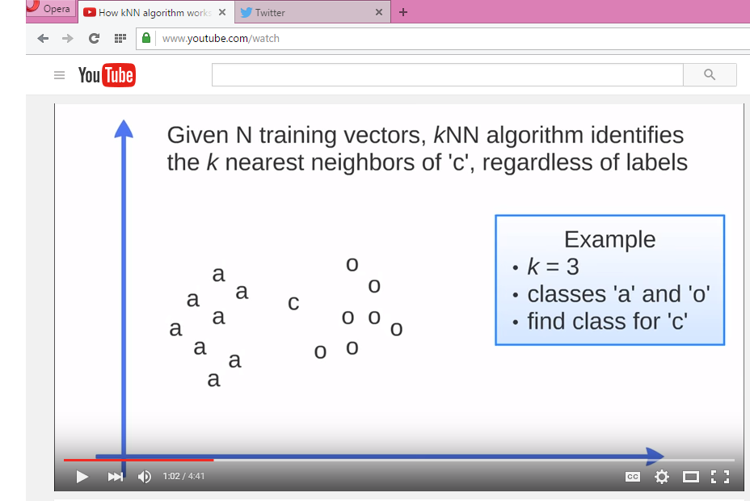
In this figure, the nearest neighbors of c is one a & 2’s o then the c is going with o .
This is simplest form of K-NN.

Slide 6
What is DISTANCE FUNCTION?
A distance metric or distance function is a real-valued function d, such that for any coordinates x, y,and z:
1. d(x,y) 0, and d(x,y) = 0 if and only if x = y
2. d(x,y) = d(y,x)
3. d(x,z) d(x,y) + d(y,z)

Slide 7
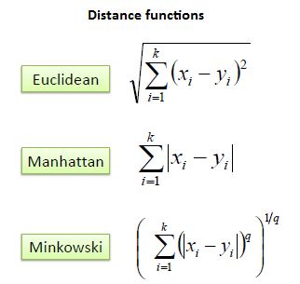
There are three distance functions in K-NN algorithm.These are given below:
It should also be noted that all three distance measures are only valid for continuous
variables.

Slide 8
Euclidean distance
Euclidean distance, which represents the usual manner in which humans think of distance in the real world:
dEuclidean(x,y) =root(∑(xi − yi )2)
where x = x1, x2, . . . , xm, and y = y1, y2, . . . , ym represent the m attribute values of two records.

Slide 9
dEuclidean(x,y) =√∑(xi − yi )2
=√ (20 − 30)2 + (12 − 8)2
=√(100 + 16) = 10.77
Here, x1 = 20, x2 = 12,y1=30,y2=8
(20,12)
Na/K Ratio
(30,8)
Age
Figure 5.9 Euclidean distance.

Slide 10
Advantages
It is simple.
Analytically tractable
Uses local information, which can yield highly adaptive behavior.

Slide 11
Disadvantages
It is computationally expansive
It is prone to overfitting.
Highly susceptible to the curse of dimensionality
Large storage requirements

Slide 12
Applications
Medicine
Agriculture
Text mining
Disease(like as,Breast cancer,Cervical cancer)

Slide 13
THANK YOU

